Slide 1
Introduction to Data Science – Week 7
Daniel D. Gutierrez
Data Scientist
COM SCI X450.1
UCLA Extension

Slide 2
Course Outcomes – Week 7
The ability to perform numeric exploratory data analysis (EDA)
Notes:
This is WEEK 7 of the Introduction to Data Science course offered by UCLA Extension. This module covers exploratory data analysis materials.

Slide 3
Lesson Objectives – Week 7
Use numeric Exploratory Data Analysis (EDA) for knowledge discovery and statistical analysis
Perform simple data analysis
Use basic R statistical functions
Independent study: common statistical tests for continuous random variables, and discrete data (categorical)
Notes:
The lesson objectives for WEEK 7 are to use numeric exploratory data analysis (EDA) methods to become intimately familiar with the data set.
The way to gain this level of familiarity is to utilize the many features of the R statistical environment that support this effort – numeric summaries, aggregations, distributions, densities, reviewing all levels of factor variables, finding the number of non-missing values, and applying general statistical methods.
Lastly, we’ll provide a brief independent study template for you to get up to speed with common statistical tests for continuous random variables and discrete (or categorical) data.

Slide 4
Simple Data Analysis
Determine unique values found for a variable
Count unique values for a variable using SQL
Counting the number of non-missing values of a variable
Exploring contingency tables
Performing a Chi-squared statistical test
Summary statistics using summary() and str()
Examining a data sample using head() and tail()
Notes:
The first form of explorations a data scientist may wish to perform on a data set are numeric summaries or aggregations. It is often useful to become familiar with how frequently a particular value occurs in a variable. We can use R’s unique() function for this purpose.
We also can use the sqldf package we saw earlier and simply use a SQL statement for making this count.
Another useful function is summary() that goes through the entire data set and provides a number of summary statistics for each numeric variable: Min, Max, Mean, Median, first quartile, and third quartile. For factor variables, summary() shows the count of the most frequently occurring values.
R also has the head() and tail() functions to quickly show the first and last 6 records in the data set. This is useful to just get a sense of the data without too much effort. These are likely the first examinations you may wish to do with a new data set.

Slide 5
R Statistical Functions
Calculate mean, min, max, range using mean(), min(), max() and range() respectively
Calculate variance using var()
Calculate quantiles using quantile()
Calculate “Tukey five-number” summaries with fivenum()
Calculate correlation using cor()
Calculate a cumulative sum with cumsum()
Viewing a simple data distribution using “stem-and-leaf” plot with stem()
Notes:
Another group of R functions that can perform many of the elements of the summary() function individually, on a specific quantitative variable are: mean() to compute the arithmetic mean, min() to find the minima, max() to find the maxima and range() to return a vector containing both the minimum and maximum value.
There’s also the quantile() function to compute the minimum, lower quartile, median, upper quartile, and maximum values. The fivenum() function returns the Tukey five-number summaries: (minimum, lower-hinge, median, upper-hinge, maximum)
The var() function calculates the variance of a variable. The variance is a numerical value used to indicate how widely individuals in a group vary. If individual observations vary greatly from the group mean, the variance is big; and vice versa.
The cor() function computes a statistical correlation. Statistical correlation is a statistical technique which tells us if two variables are related.
Finally, cumsum() calculates a cumulative sum of a vector without writing any code.

Slide 6
Independent Study: Common Statistical Tests
R functions for common statistical tests for continuous random variables
t.test() - Student's t-test
var.test() - F-test
aov() - analysis of variance
pairwise.t.test() - t-test between every pair of groups
shapiro.test() - Shapiro-Wilk test
ks.test() - Kolmogorov-Smirnov test
cor.test() - Pearson's or Spearman's rank correlation
wilcox.test() - Wilcoxon's rank test: non-parametric equivalent to t-test
kruskal.test() - Kruskal-Wallis rank-sum test
flinger.test() - Flinger-Killeen (median) test
Notes:
In order to gain even more insight into a given data set, you’ll need to employ common statistical methods. Since this is not a class on statistics (that would require mathematics), the associated Code module will present a common statistical test for continuous variables.

Slide 7
Independent Study: Common Statistical Tests
R functions for common statistical tests for discrete data (categorical)
prop.test() - proportions test
binom.test() - Binomial distribution test
fisher.test() - Fisher's exact test
chisq.test() - chi-squared test
mantelhaen.test() - Cochran-Mantel-Haenszel test
friendman.test() - Friedman rank-sum test
Notes:
In order to gain even more insight into a given data set, you’ll need to employ common statistical methods. Since this is not a class on statistics (that would require mathematics), the associated Code module will present a common statistical test for categorical variables.

Slide 8
Independent Study: Common Statistical Tests
For quality vignettes, search for R-oriented tutorials on each R statistical function on: http://www.r-bloggers.com/
For example, here is a good tutorial for the chi-squared test: https://freakonometrics.hypotheses.org/20531

Slide 9
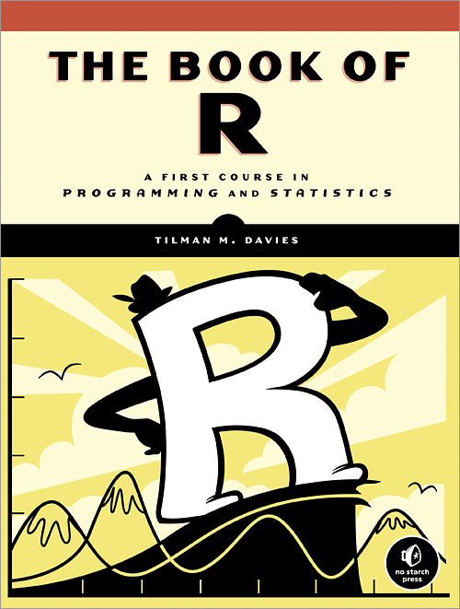
Independent Study: Common Statistical Tests
Notes:
“The Book of R” by Tilman M. Davies published by No Starch Press (2016) is the best book on statistics for data scientists using the R language. 792 pages! Parts III and IV are great.

Slide 10
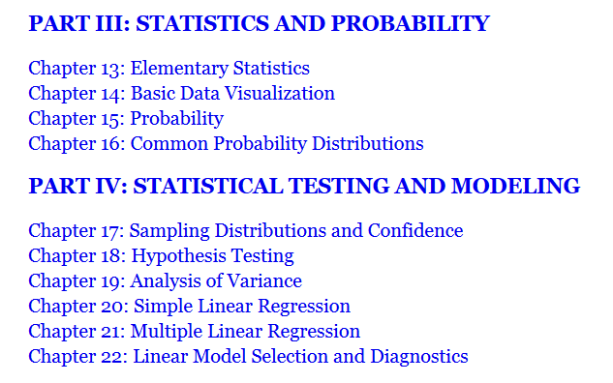
Independent Study: Common Statistical Tests
Notes:
Part III of The Book of R provides a straightforward introduction to statistics and probability theory.
Part IV of The Book of R dives deeper into statistics with topics of statistical testing and modeling.

Slide 11
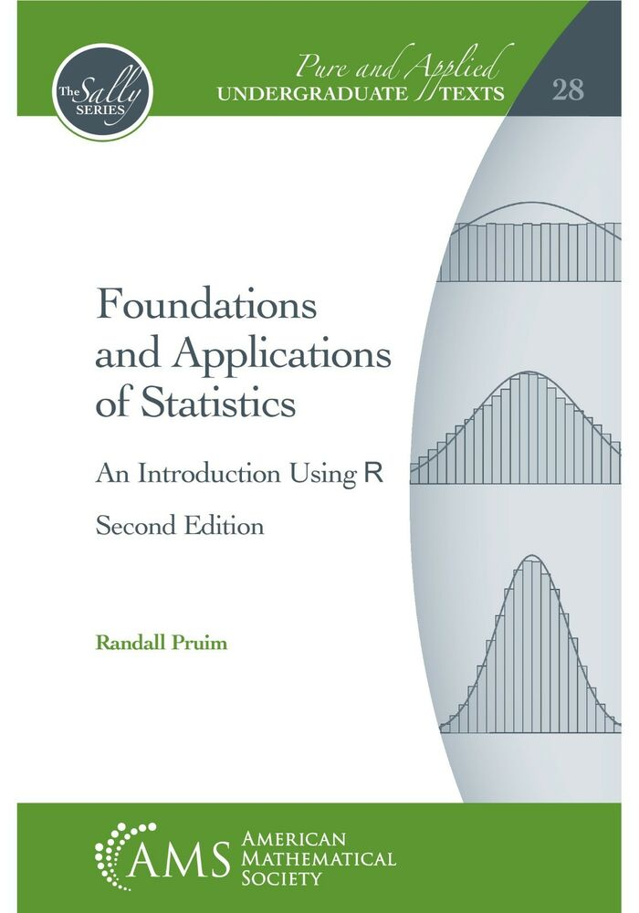
Independent Study: Common Statistical Tests
Notes:
Another excellent, although more mathematical, book on statistics for data scientists is “Foundations and Applications of Statistics – An Introduction Using R,” 2nd Edition, by Pruim Randall, published by AMS (American Mathematical Society), 2018. Another whale of a book at 820 pages!

Slide 12

Independent Study: Common Statistical Tests
Notes:
This is a nice book for data scientists – “Statistics Done Wrong,” by Alex Reinhart, published by No Starch Press (2015), 152 pages.

Slide 13
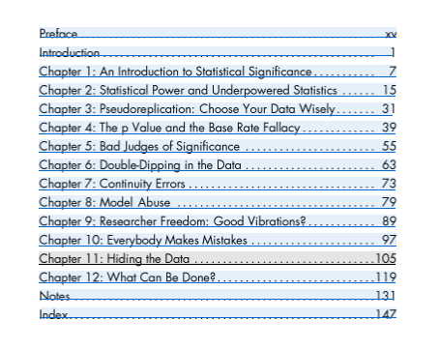
Independent Study: Common Statistical Tests
Notes:
This is a nice book for data scientists – “Statistics Done Wrong,” by Alex Reinhart, published by No Starch Press (2015), 152 pages.

Slide 14
Code Module 7
WEEK 7-1 Code module – Simple data analysis
WEEK 7-2 Code module – R statistical functions
Notes:
In order to demonstrate the concepts for WEEK 7, we’ll step through a series of in-depth R code examples found in the Code modules listed.
I encourage you to take the R script file for WEEK 7 and try each code snippet yourself. Take some time to tweak each example and try different things so you’ll fully understand each programming concept.
In addition, for WEEK 7 I recommend that you study a resource for statistics in order to get familiar with the common statistical tests outlined.

Slide 15
Summary
In WEEK 7 of Introduction to Data Science, we built up our toolbox of EDA methods in order to gain familiarity with a data set.
The methods discussed represent a small sample of available techniques. As you progress as a data scientist, you’ll pick up more statistics that will help out in this step of the data science process.

Slide 16
UCLA Extension

